Slide 1
Guide to repack & use SD Biosensor ART test kits

Slide 2
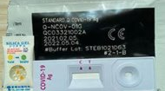
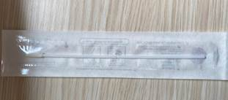
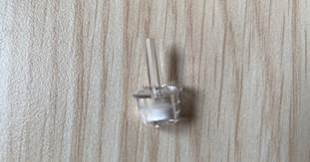
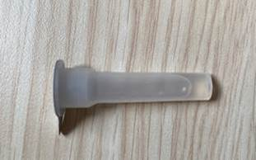
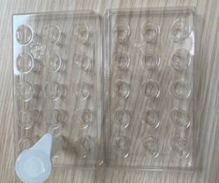
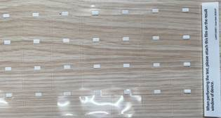
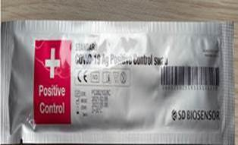
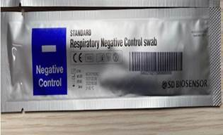
Items inside SD Biosensor Box
Items in one box | SD Biosensor Standard Q | Qty | Needed for Individual Testing?
Test Device (wrapped individually in foil pouch with desiccant) |  | 25 | Yes - to break bulk
Sterile Swab Stick |  | 25 | Yes - to break bulk
Nozzle Cap |  | 25 | Yes – to break bulk
Extraction buffer tube |  | 25 | Yes – to break bulk
Buffer Tray |  | 2 trays | No – not essential to individual testing, not required to break bulk (This is to hold the extract buffer tubes in a mass swab setting.)
Plastic Film |  | 1 | No – not essential to individual testing, not required to break bulk (This is to cover the test device to prevent contamination by dust in a mass swab setting. If the individual's swab setting is generally dusty, the test device may be protected by using a sterile clear plastic bag.)
Standard COVID-19 Ag+ Positive Control Swab |  | 1 | No – not essential to individual testing, not required to break bulk (This is a control swab manufactured to verify the user’s ability to properly perform the test and interpret the results.)
Standard Respiratory Negative Control Swab |  | 1

Slide 3
Steps for repacking art kits (IF REQUIRED)
Preparation
Clean packing surface with alcohol wipe.
Put new box of kits on table surface.
Disinfect hands.
Wear face shield, face mask, and gloves. Minimise talking from this point onwards.
Maintain safe distance of 2m between packers.
Packing
Ensure each individual kit has 1x Test Device, 1x Swab Stick, 1x Nozzle cap, 1 x Extraction Buffer Tube.
When done with 1 box, disinfect hands with gloves on, using 70% alcohol hand rub.
The Other Items
The Buffer Tray, Plastic Film, Standard COVID-19 Ag+ Positive Control Swab and the Standard Respiratory Negative Control Swab are not required.

Slide 4
Instructions on how to use SD Biosensor
Self-Swab Instructions | PDF File for Printing
English

